Slide 1
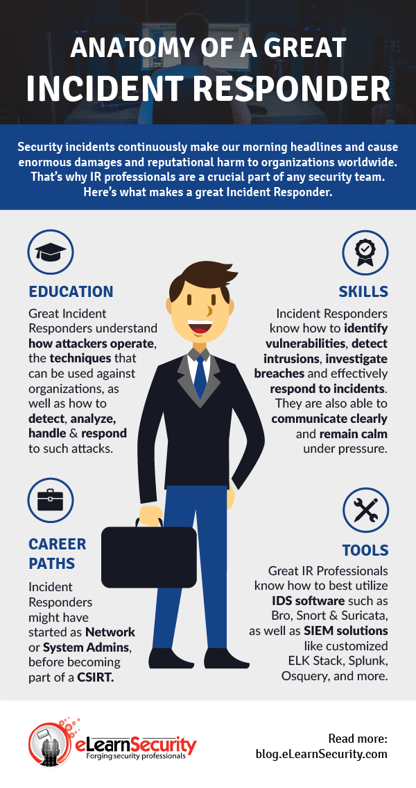
Professional Incident
Responders Inc
Group Members
Duane Samuels
Jordan Lemite
Justin Prosser
Yemsrach Asrat

Slide 2

Overview
Congratulations Summit Card Union, your company got hacked! You probably have a lot of questions on your mind and my team of highly trained incident responders will go over the steps of the attack, how you can respond to the attack, and how you can mediate a defence.

Slide 3
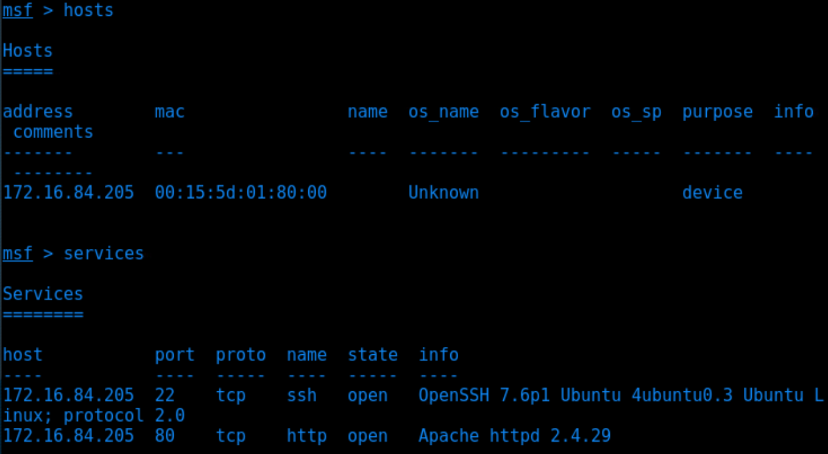
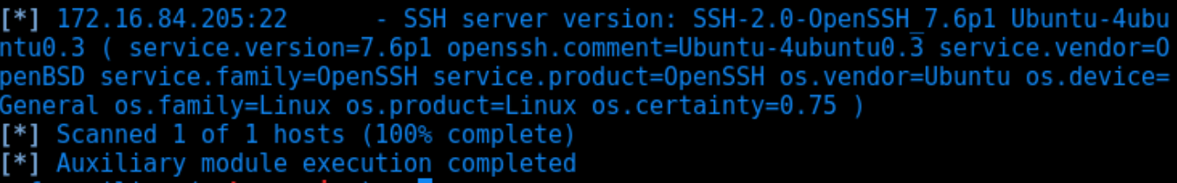
Reconnaissance
At 16:31:23 IP Address 172.16.84.213 started sniffing for information.
They performed a nmap scan of your site
They browsed your site looking for useful info

Slide 4
Brute-Force
At 16:32:19 IP Address 172.16.84.213 started a hydra brute force attack on the /company_folders/secret_folder using ashton as a login
After 10145 attempts the attacker was able to get ashton’s password: leopoldo

Slide 5
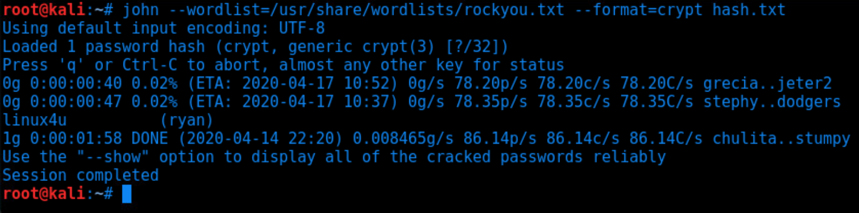
Login Info
As a general rule of thumb leaving obvious instructions in easy to reach places makes it easier for the attacker to escalate their privileges. (ryan:linux4u)
The attacker was able to crack the hash that you had stored in the secret folder
Oh and you also just told the hacker where they can upload files to.

Slide 6
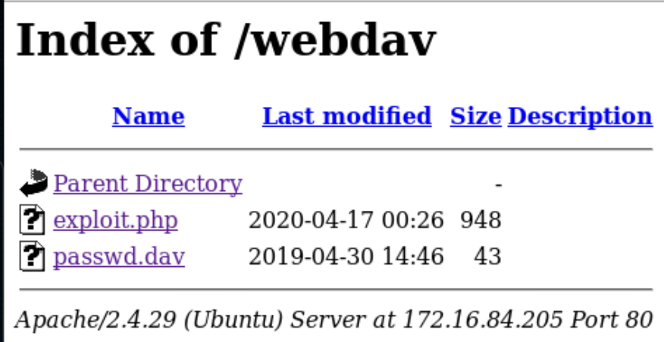
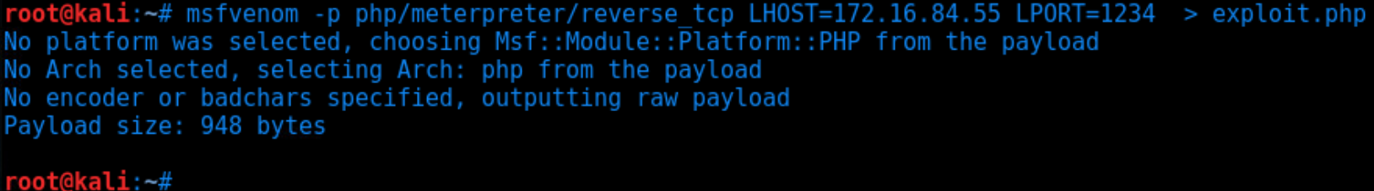
Getting system access
Now that the attacker knows about the webdav server the attacker was able to use msfvenom to create a exploit.php script to upload to your web server and use it to create a meterpreter session.

Slide 7
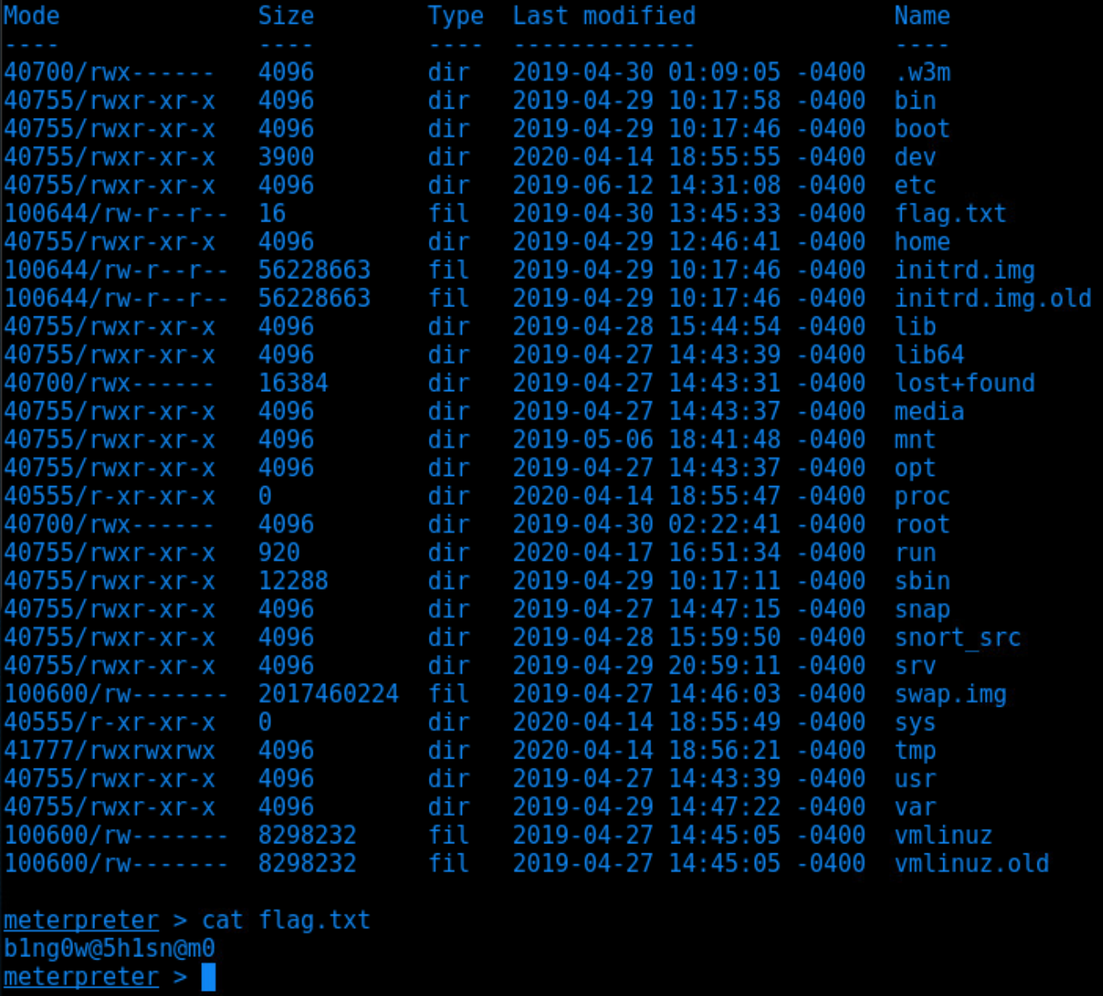

Success!
As you can see the attacker was able to create a meterpreter session and successfully grab valuable data from your server.

Slide 8
Incident Response: Detect and Analyze
What time did the attack start and how long did it last?
The attack began at 16:31:23
It lasted 9 minutes and 33 seconds
What was the IP address of the attacker?
The hacker’s IP address was 172.16.84.213
Who was the attacker trying to login as?
Ashton, starting at 16:32:29
Ryan at 16:37:00

Slide 9

Incident Response: Detect and Analyze
Was the attacker successful?
Yes, in packet number 60903 at 16:36:23 the password was found
How many passwords did the attacker use before they found the correct password?
10146
Rockyou.txt - dictionary wordlist

Slide 10


Incident Response: Post-Incident
What kind of attack was the attacker using?
Brute force password attack
PHP web shell exploit
How is this reflected in the report?
Reflected in the steps of our attack
Reflected in the mediation

Slide 11
Mediation
How would you protect your servers from these attacks? By understanding the kinds of attacks your agency just was exposed by, we will implement the following steps to block brute force attacks, password hash cracking and preventing shell upload vulnerabilities in PHP to strengthen your security features.
Detect and ascertain the source (IDS):
Ensure security indicators are monitored by:
Investigating reports of incidents from administrators, staff, and users
Regularly scheduled checks of the security product generating alerts based on analysis of log data
Possible look fors: 200 status code (found valid password), 401 status code (failed login attempts)
Implement prevention techniques to Brute Force Attacks:
Device Cookies: distinguish between known/trusted and unknown/untrusted clients, establish universal temporary lockouts for all untrusted clients, lockout trusted clients individually
Alter behavior for failed passwords: instead of the predictable 401 status code with a failed password attempt, alter the responses to return different error messages each time and/or let the user through and request the password again.
Assign unique login URLs to blocks of users so that not all users can access the site from the same URL

Slide 12
Mediation
Cont.
Implement prevention techniques against password hash cracking:
Personnel requirements: ensure to implement a strong password policy focusing on length, complexity, no personal information, no dictionary words or common misspellings, and no predictable habits such as identical formats
Define workstations such as HR workstations, Finance workstations, and etc. Then assign a domain account with administrative privileges over the hosts in the specific group. Configure the account to not be able to access any other services or hosts, which supports limiting the breach to that particular perimeter.
Implement least privilege access rights for users providing them the bare minimum privileges necessary to perform its function.
Implement prevention techniques against preventing shell upload vulnerabilities in PHP:
Require authentication to upload files
Store uploaded files in a location not accessible from the web
Scramble uploaded file names and extensions
Define valid types of files that the users should be allowed to upload

Slide 13
Mediation
Are there any other vulnerabilities that the server would be prone to? What are they? How would you fix those?
SSH (open port 22)
Set a custom SSH port: the default port for SSH is 22, susceptible to brute force attacks -- set the port to another port number
Disable root login: root login is allowed on most Linux operating systems, allowing anyone to connect to port 22, and use root user as default allowing more brute force attacks -- disable root login and use a primary SSH user instead
HTTP (open port 80):
Configure the web server to send the response to port 80 request and redirect user to https port 443

Slide 14
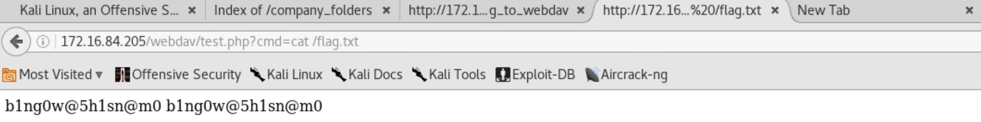
Mediation
3. The server also vulnerable for PHP code injection which enables the attacker to execute the webdav server and get the valuable data.
Apply proper input variable validation
Check for invalid characters and setup all the page files in a separate directory
To avoid this problem we recommend :
Disable exec(), shell_exec(), passthru(), and system() functions unless it’s very necessary in PHP configuration
Create a whitelist of accepted commands/arguments

Slide 15
THE END
Any questions?

